Slide 1

Design of FMCW Radar Based on Software Defined Radio with GNURadio for Detection, Range Estimation, and Velocity of an Object
Bima Pancara Haryono Putra
1101210528
Supervisor
Dr. Fannush Shofi Akbar, S.ST.
Risdilah Mimma Untsa, S.ST., M.T.

Slide 2

OUTLINE
Basic Overview
Objectives
Research Flowchart
Data Acquisition
Data
Analysis
Conclusion
Contribution

Slide 3
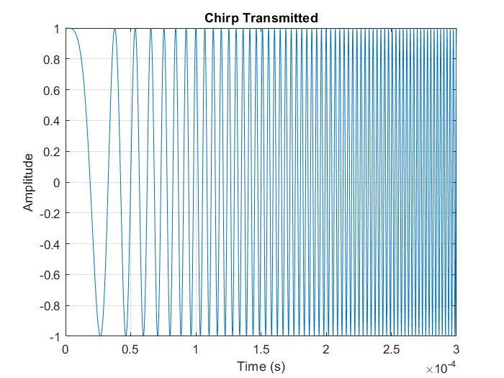
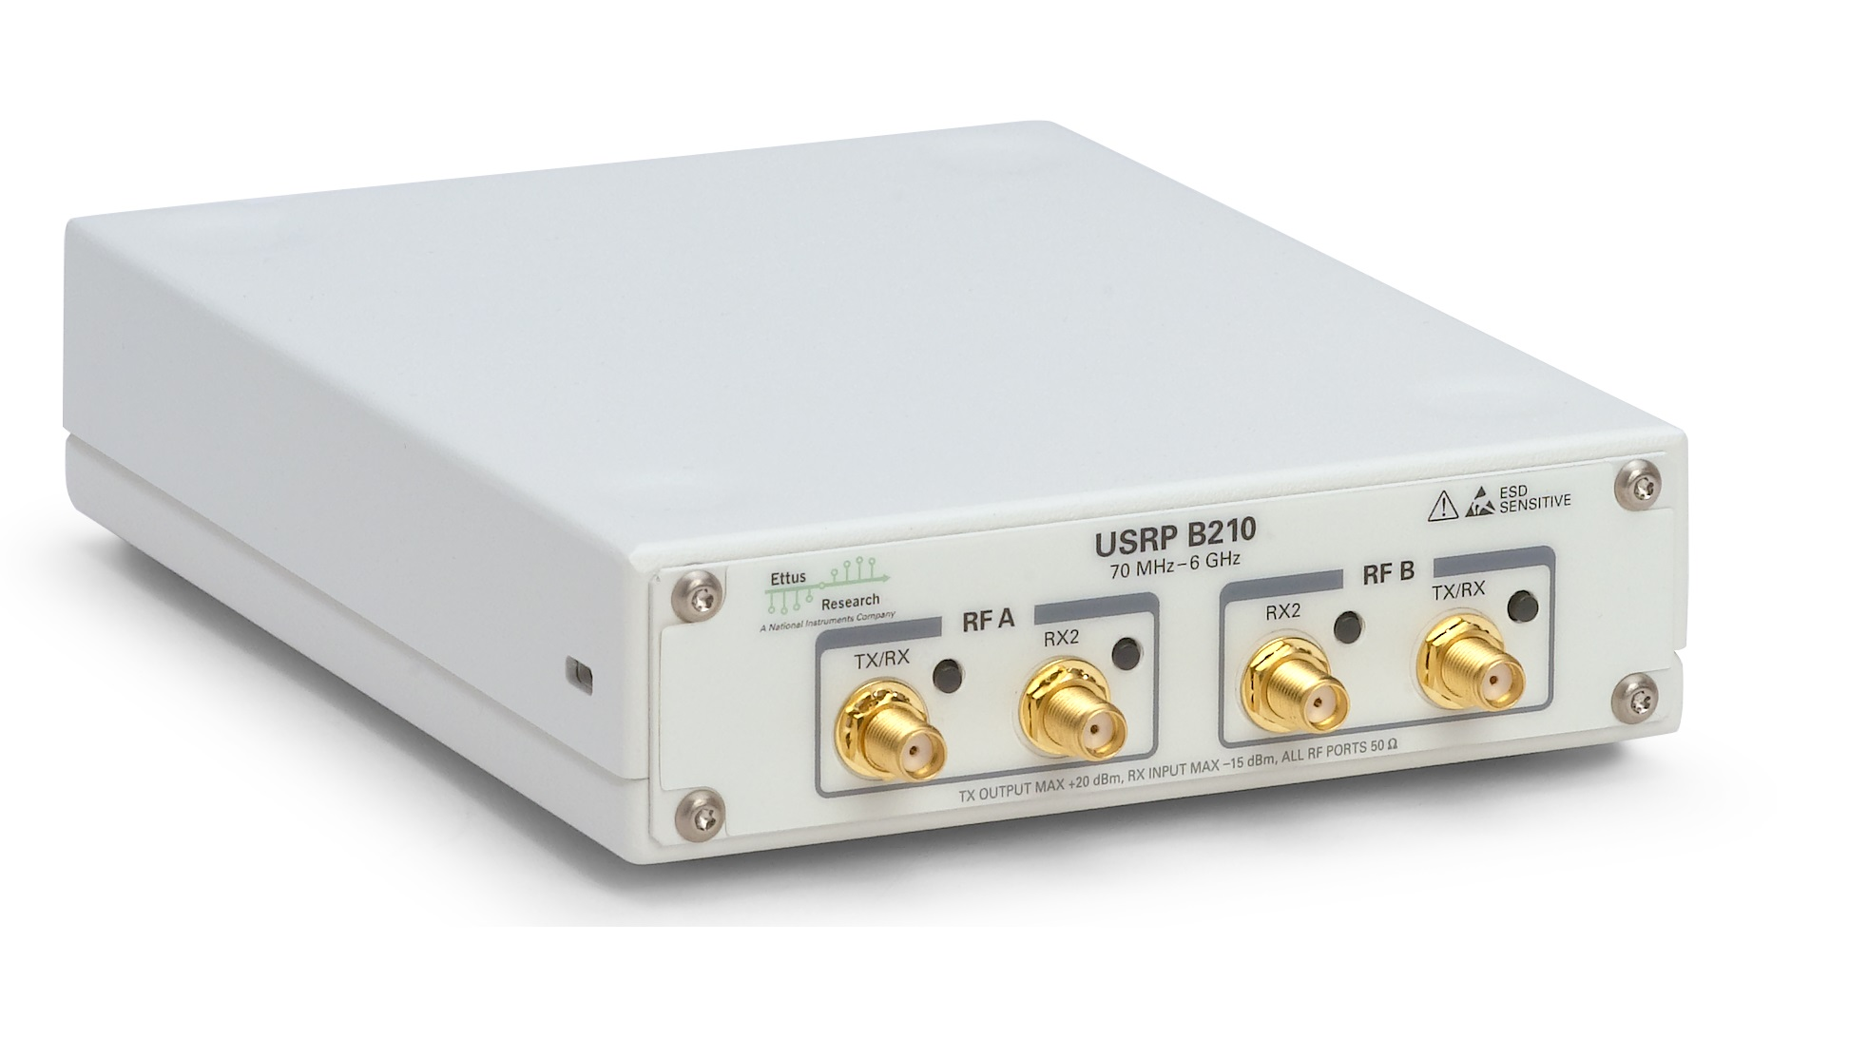

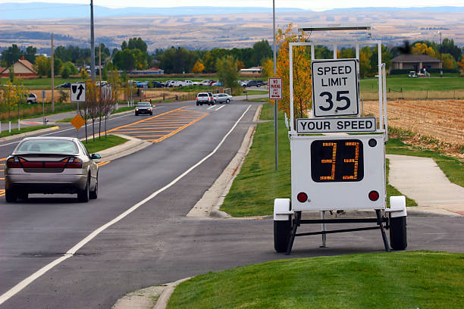
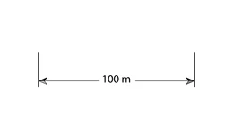

Slide 4
OBJECTIVES
Designing FMCW Radar system with GNURadio and USRP B210
Test the system’s ability to detect, estimate range and, the velocity of an object
Evaluating the designed System

Slide 5
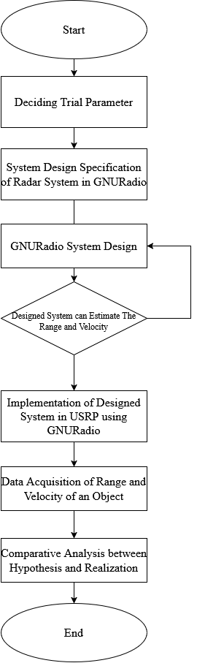
Done After Proposal

Slide 6
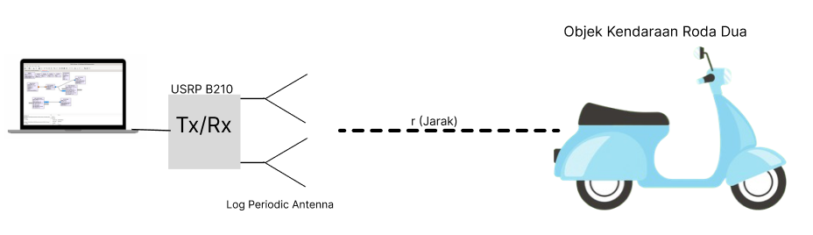
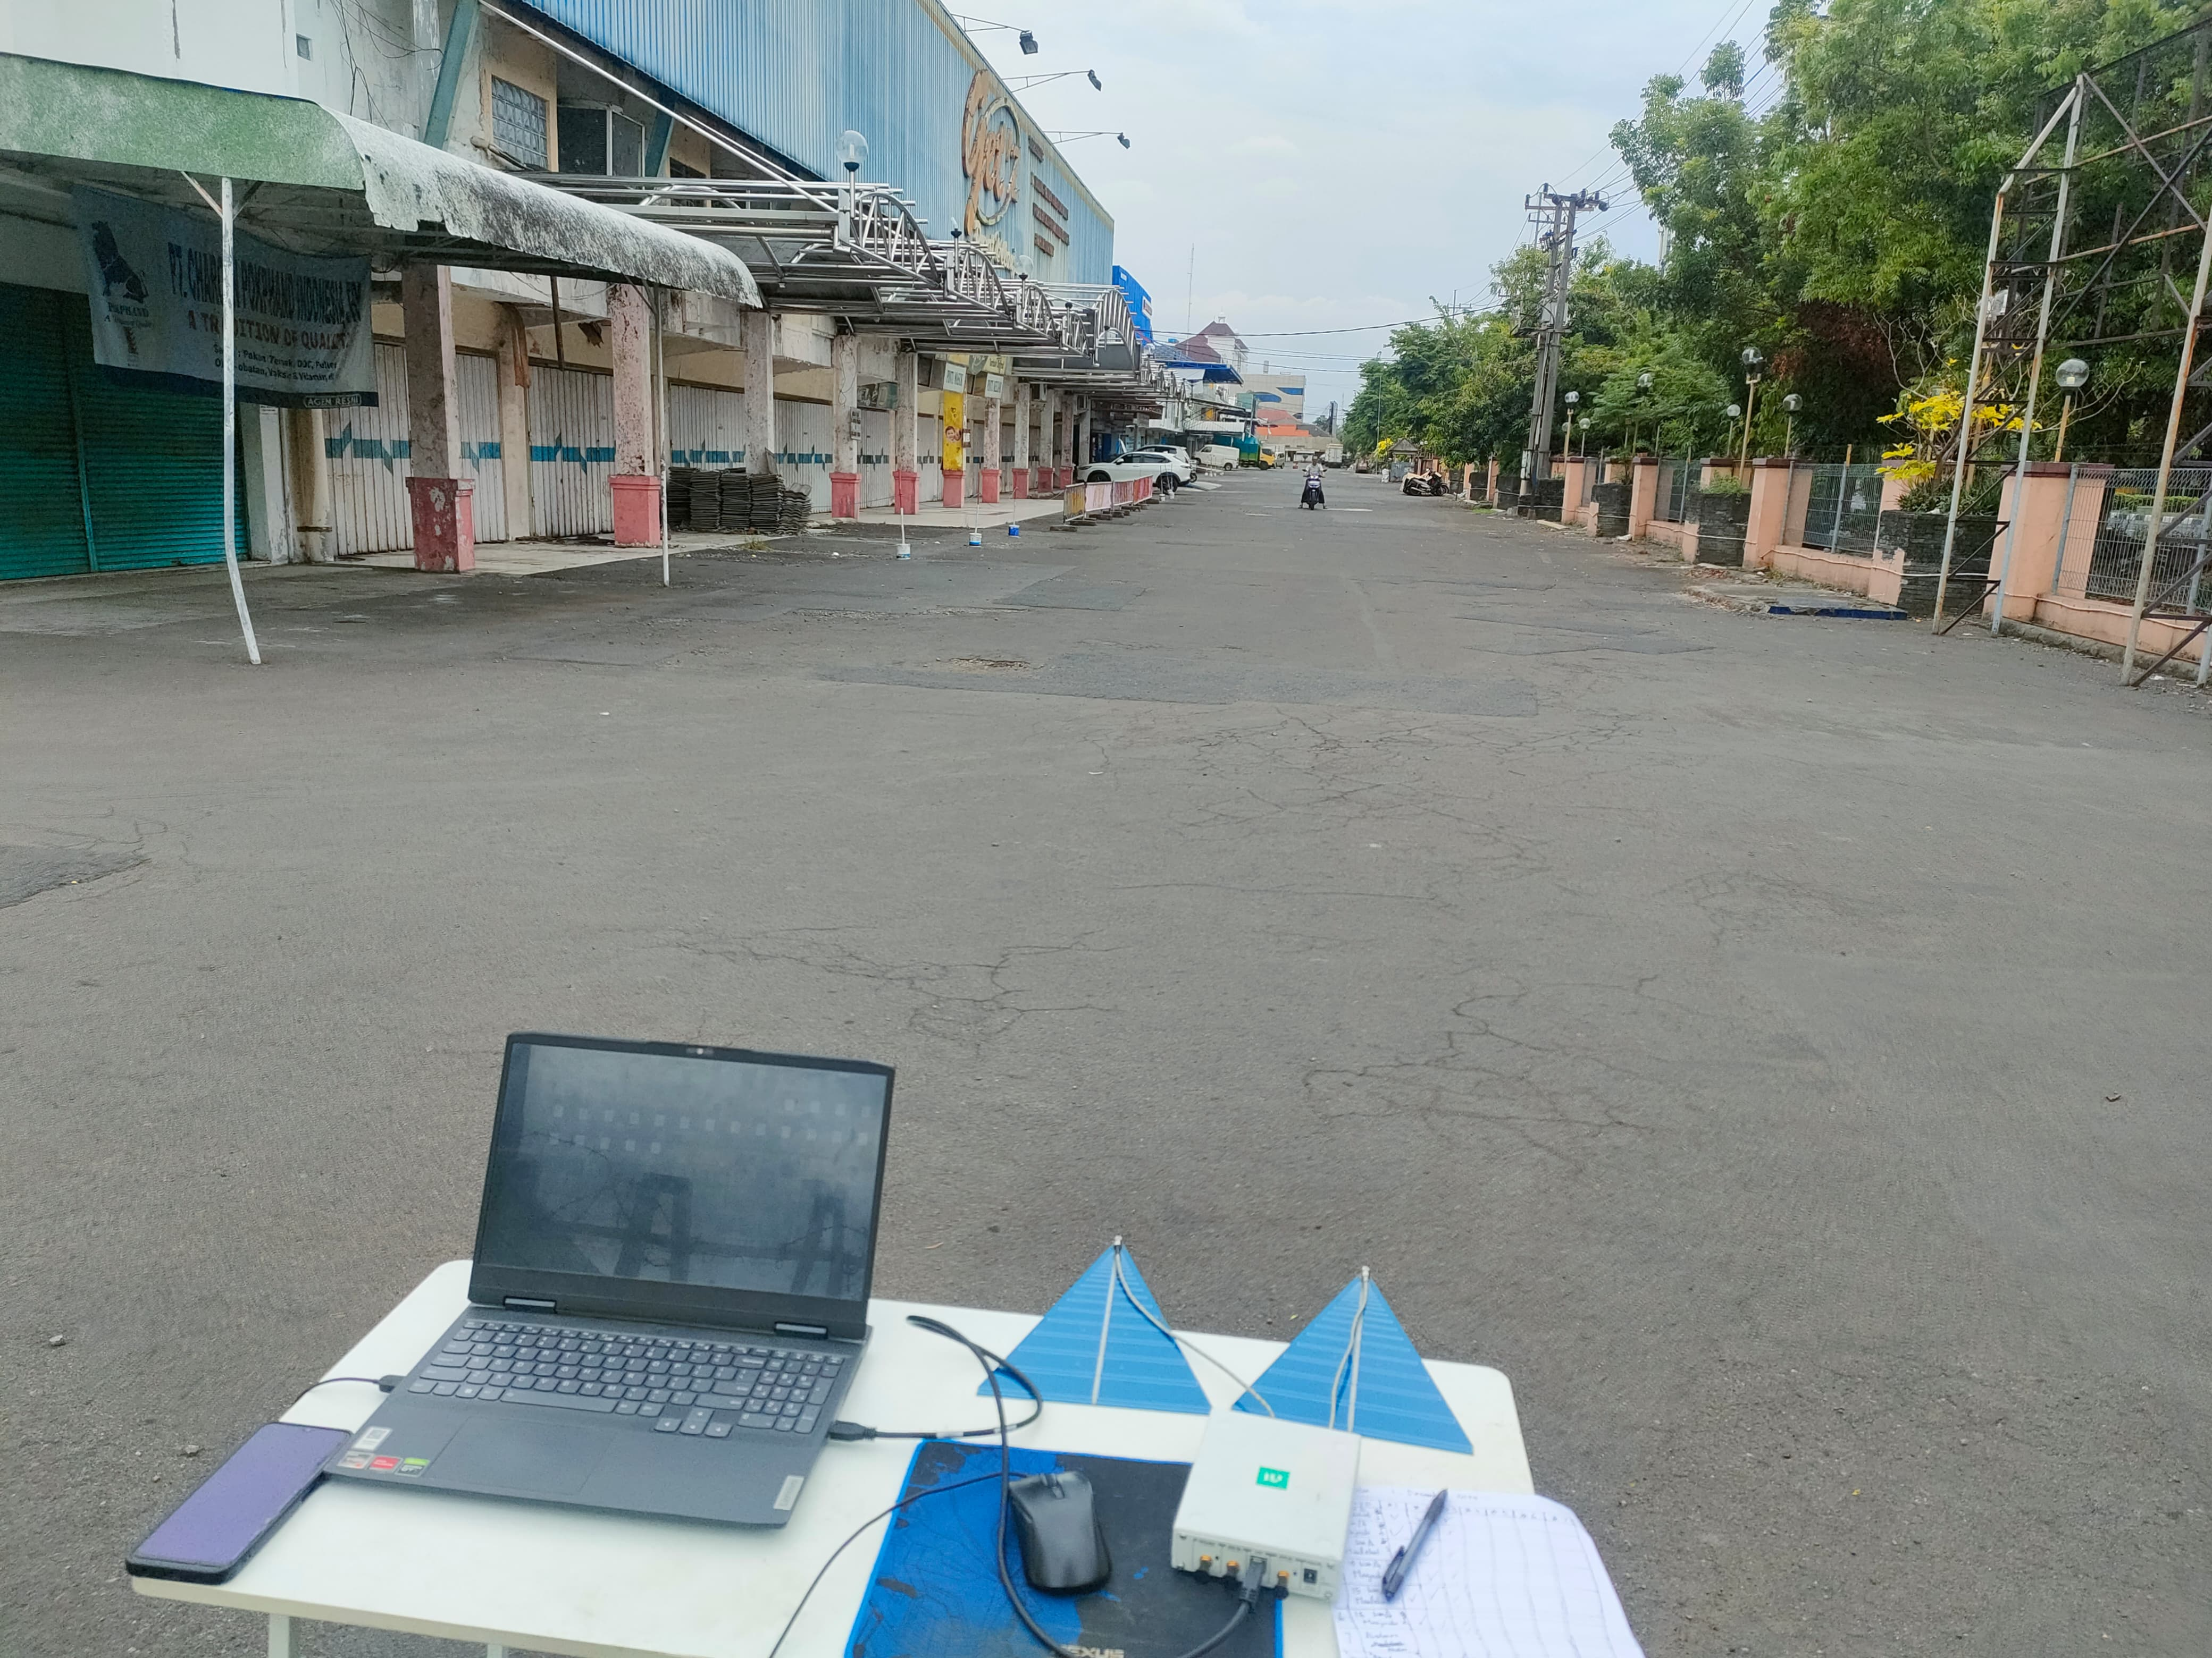
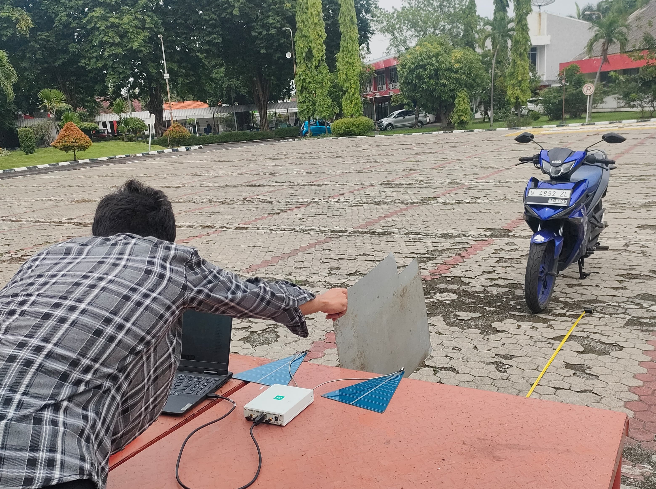
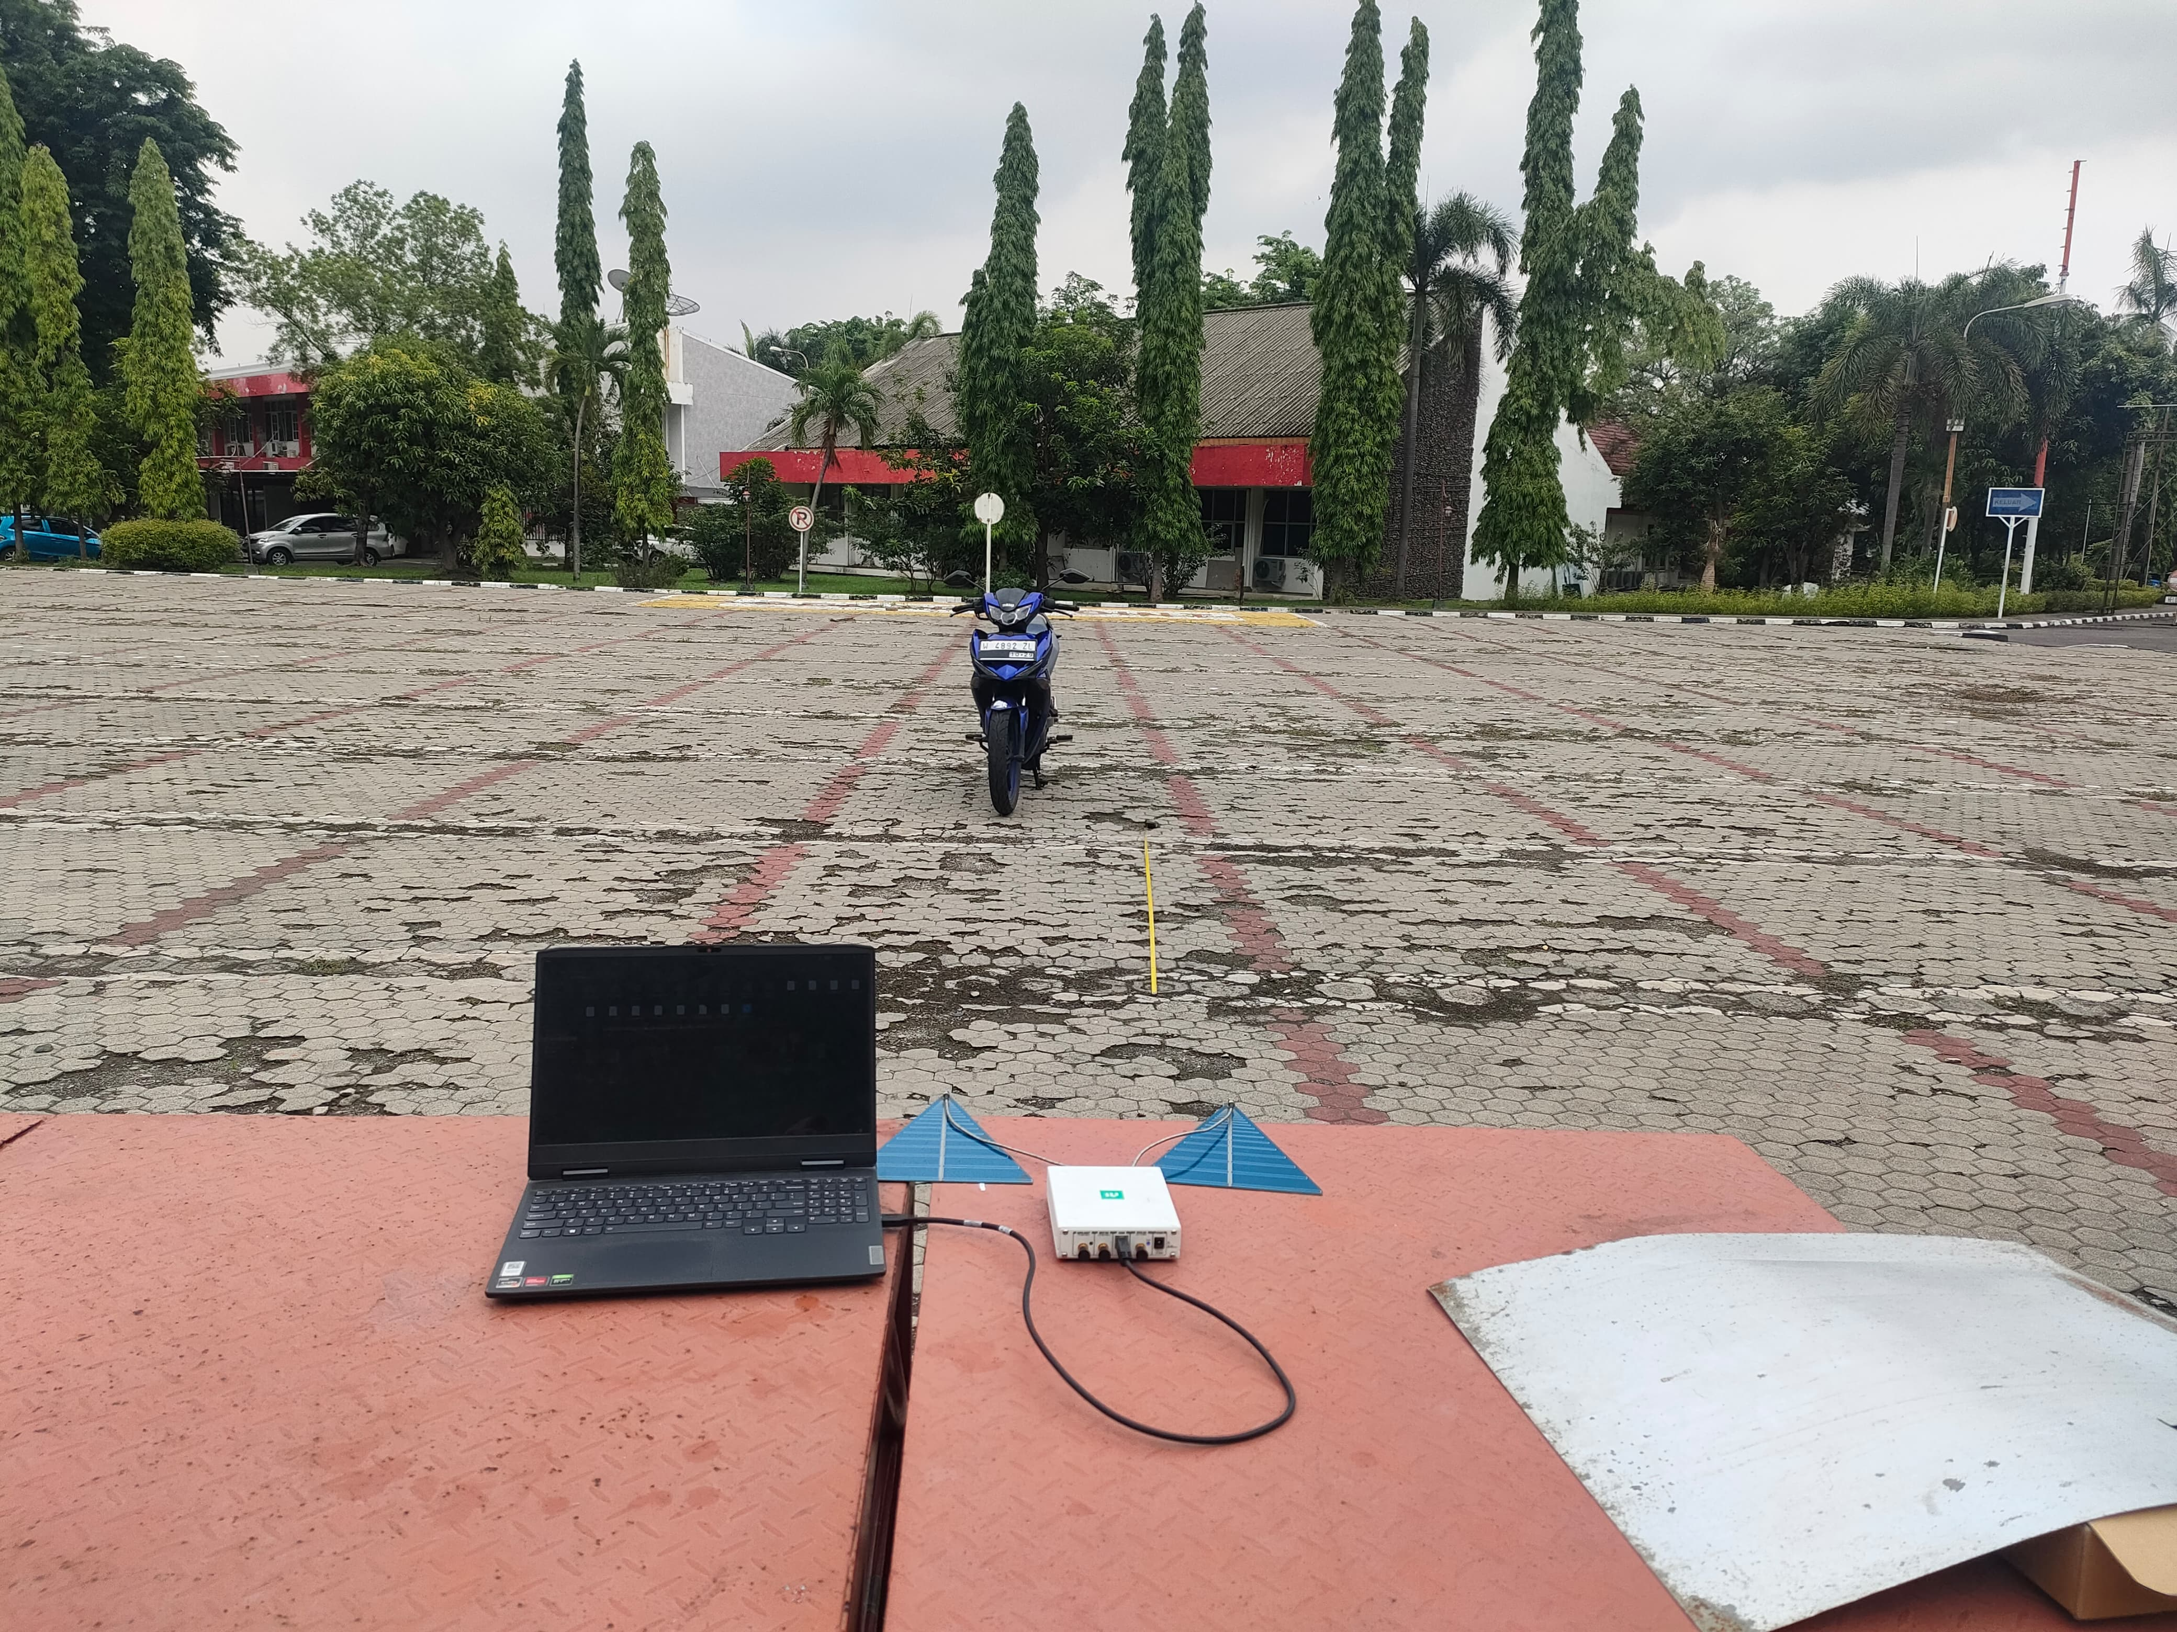
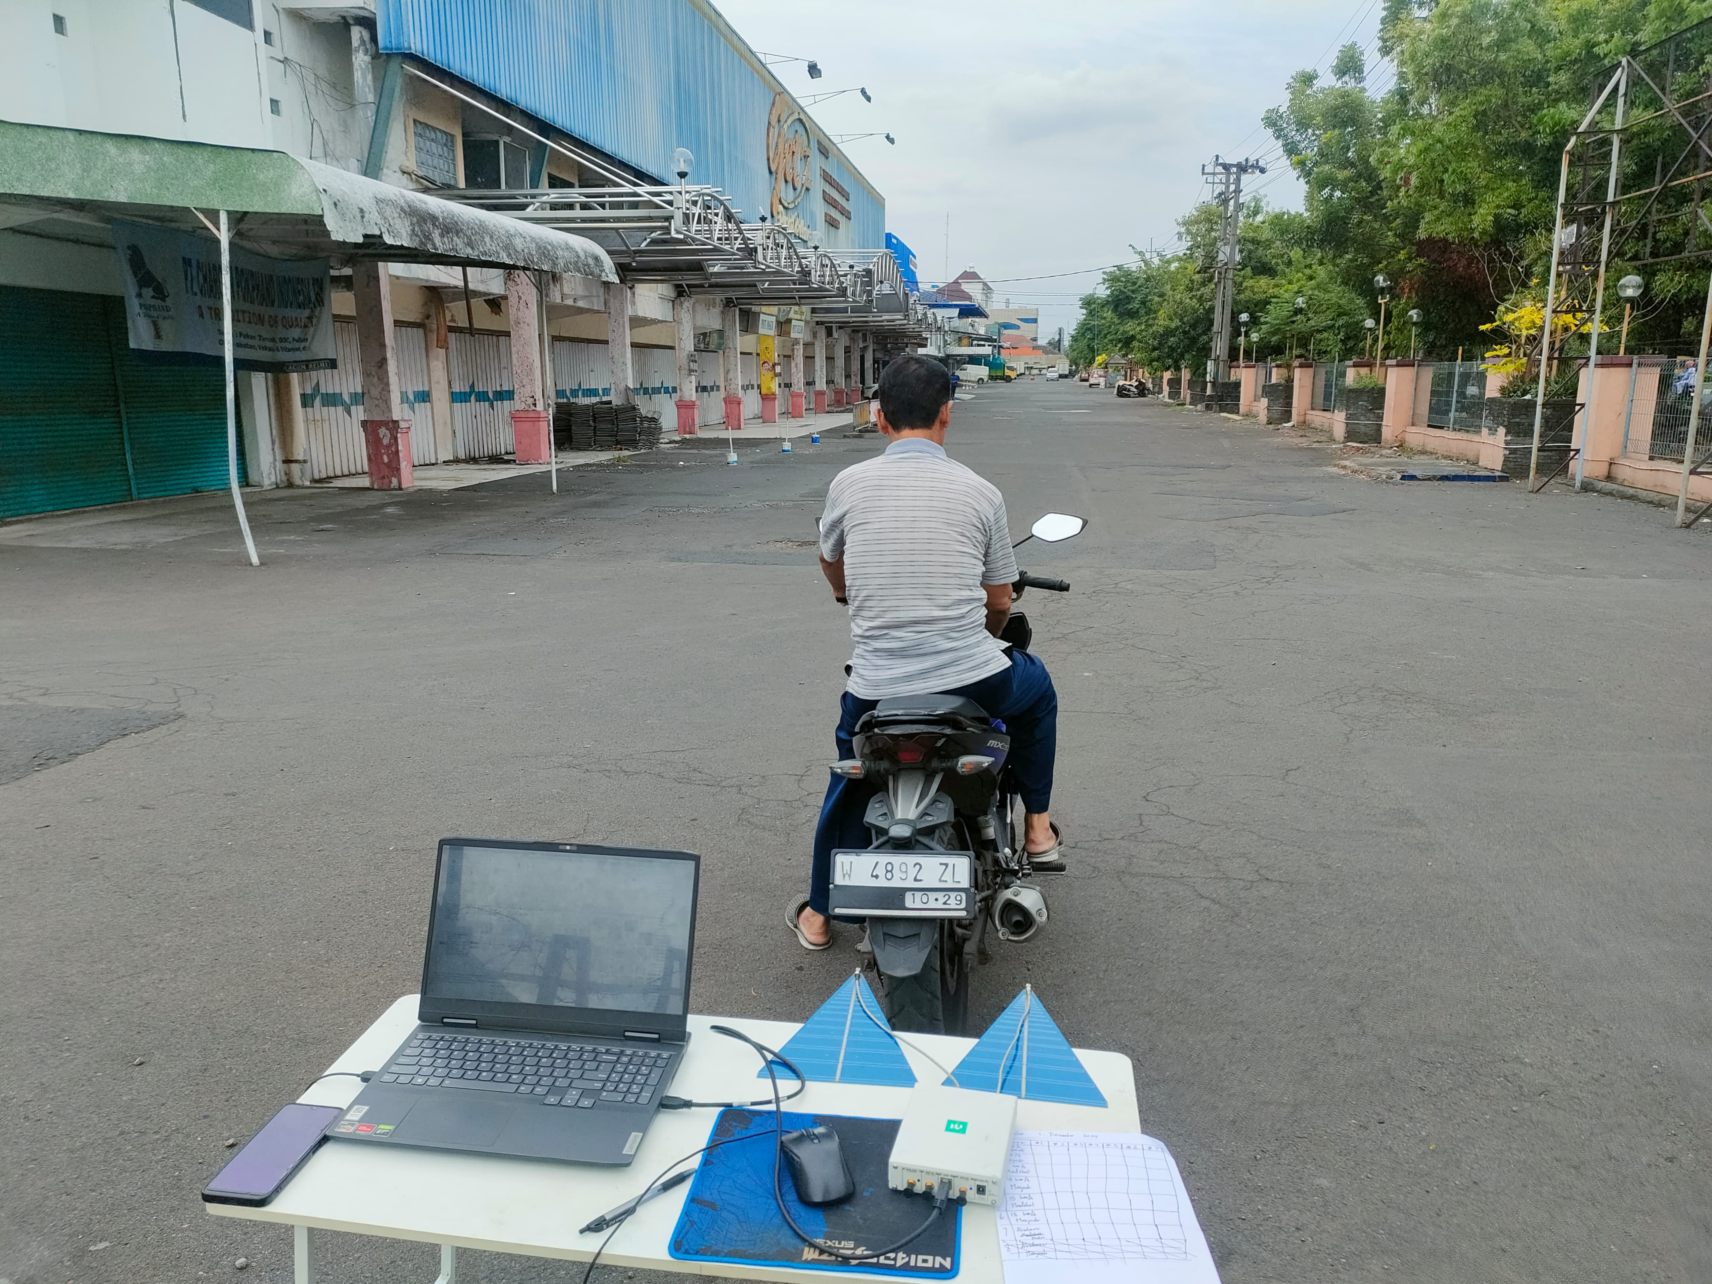

Slide 7
DATA
Actual Range (m) | Predict Range (m) | Trial | Absolute Deviation
3 | 55,04 | 1 | 58,04
3 | 7,3192 | 2 | 10,3192
3 | 8,4902 | 3 | 11,4902
6 | 7,0264 | 1 | 1,0264
6 | 6,7336 | 2 | 0,7336
6 | 5,5626 | 3 | 0,4374
9 | 9,0757 | 1 | 0,0757
9 | 9,0757 | 2 | 0,0757
9 | 8,7830 | 3 | 0,2170
Actual Velocity (km/h) | Predict Velocity (km/h) |  | Trial
 | Approaching Radar | Receding Radar
5 | 0 | 0 | 1
5 | 0 | 0 | 2
5 | 0 | 0 | 3
10 | -9,8 | 10,3 | 1
10 | 0 | 0 | 2
10 | 0 | 0 | 3
15 | -18,03 | 0 | 1
15 | 0 | 0 | 2
15 | 0 | 0 | 3
20 | 0 | 0 | 1
20 | 0 | 0 | 2
20 | 0 | 0 | 3

Slide 8
ANALYSIS
Great result in range estimation at 9 meter
Average result in range estimation at 6 meter
Bad result in range estimation at 3 meter
Bad result in velocity estimation
Can detect the movement of object
Bigger object for larger radar cross section

Slide 9
CONCLUSION
FMCW Radar has successfully been implemented
Assessment of the system has been done, the designed system can detect an object, estimate range, and velocity
The evaluation show a good range detection starting from 6 meter up to 9 meter, while velocity estimation does work, it is not reliable
This research has shown the step by step in designing FMCW radar system with USRP B210 and GNURadio

Slide 10
CONTRIBUTIONS
Giving a step by step approach on how to implement FMCW radar system on USRP B210
Assessing the ability of the designed system
As a reference on the implementation of FMCW radar using B210 USRP

